Slide 1

Karen Soriano
Alejandro Aguilar Jr.
Sean Huang
Let us take you to your destination

Slide 2

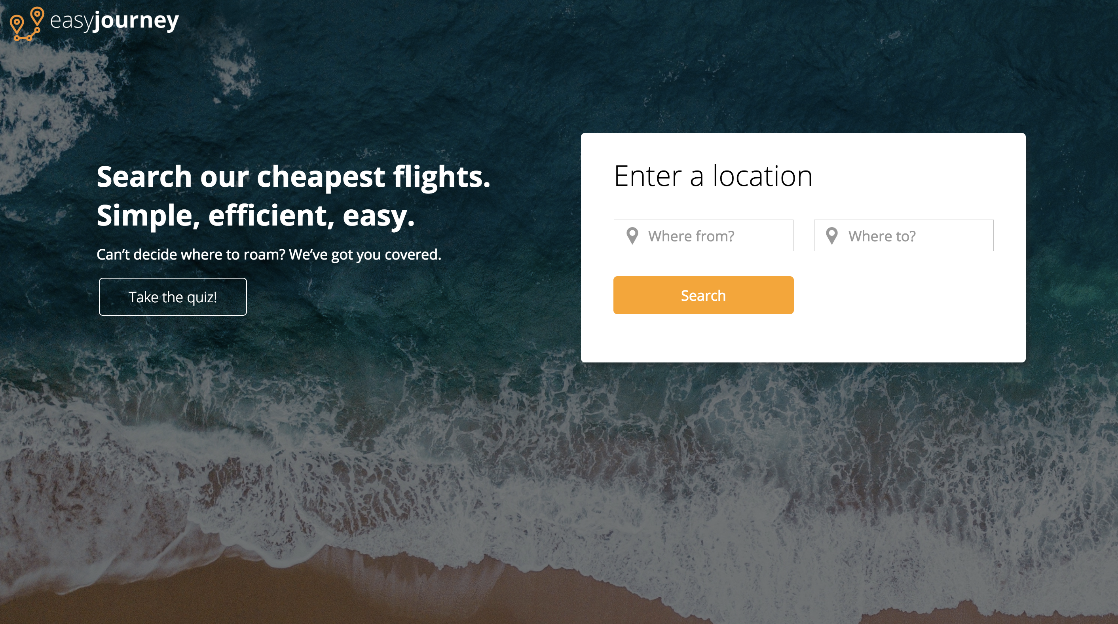
Pick a destination or let us choose for you
Enter a location
Take a quiz

Slide 3
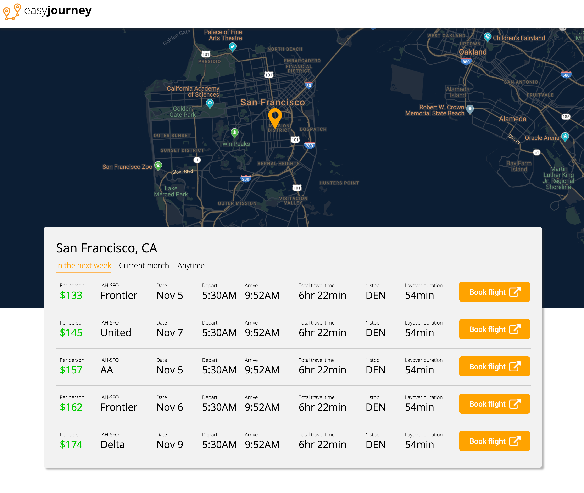
Up in the air
Airlines, prices, dates
International and domestic flights
Book flights*

Slide 4
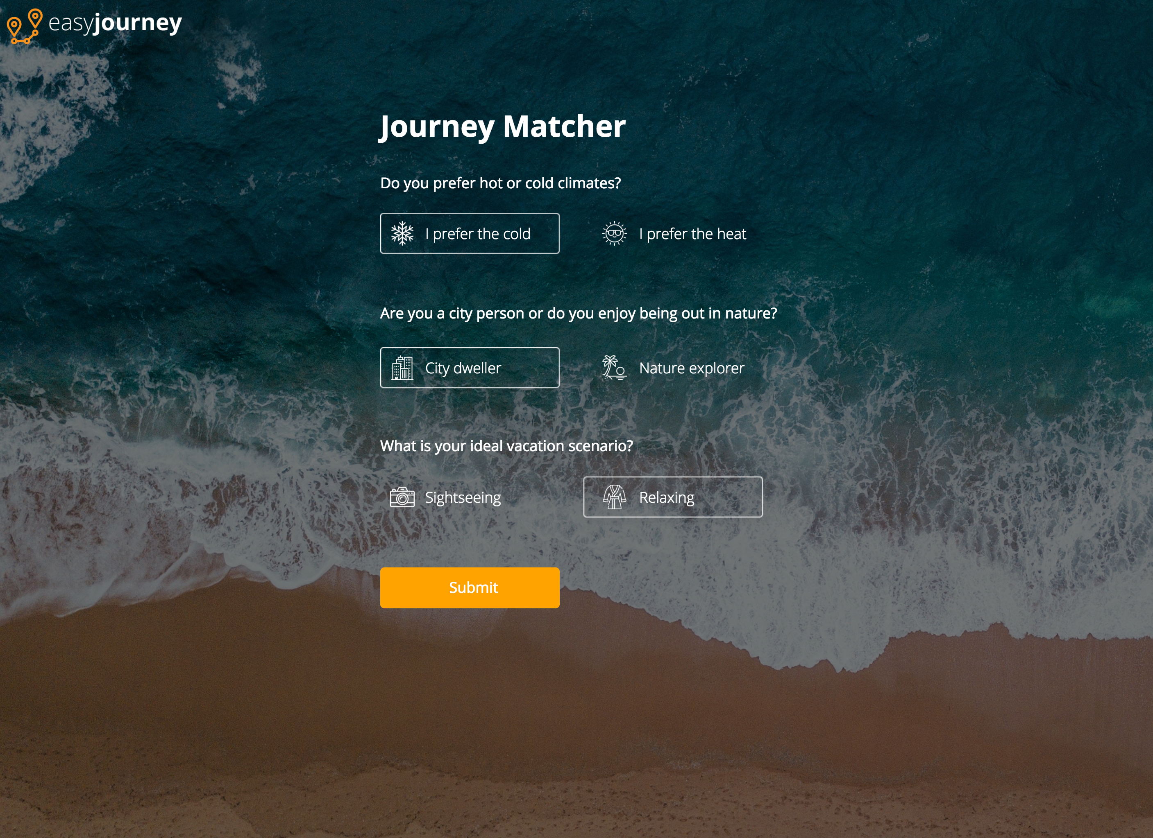
“Journey Matcher” quiz
Match preferences
Makes suggestions for users that want to travel but don’t know where to go

Slide 5
Thank you!

